Slide 1

Introduction to Blockchain Technology
Mihael Mladenov
Software University
http://softuni.bg

Slide 2

Table of Contents
Course Overview
What is Blockchain?
History of Blockchain
Key Concepts of Blockchain
Types of Blockchain
Applications & Implementations
Homework Assignment
Resources & Further Reading

Slide 3
You Have Questions?
sli.do #B-Chain-Intro

Slide 4

Course Scope and Objectives

Slide 5
Course Objectives
Understand How Blockchains Work
Understand How Cryptography is used in Blockchains
Understand Security & Legal Implications of Blockchain
Understand How Mining & the Infrastructure Work
Understand How to Use Decentralized Applications
Understand How to Work with Smart Contracts
Understand How to Value & Invest in ICOs

Slide 6
Course Scope
Introduction to Blockchain
Introduction to Cryptography
Cryptocurrencies and Decentralized Currencies
Storing and Using Coins, Wallets, Security
Mining Coins, Hardware, Infrastructure, Pools
Ethereum & Smart Contracts
Initial Coin Offerings

Slide 7

Introduction to Blockchain: More Details
Duration, Languages, Evaluation

Slide 8

Training Duration
Lectures: ~ 21 hours (onsite + YouTube videos)
Homework Tests: ~ 7 hours (online)
Final Exam (Multiple Choice): October 31, 2018

Slide 9



Scoring System
HOMEWORK
35%
EXAM
65%
EVALUATION
CRITERIA

Slide 10

Why English?
Why the slides are in English?
English is the native language of the software engineers
Specific terminology should be in English
Translations are inaccurate and funny
Just learn English!
No excuses

Slide 11

What is Blockchain?

Slide 12
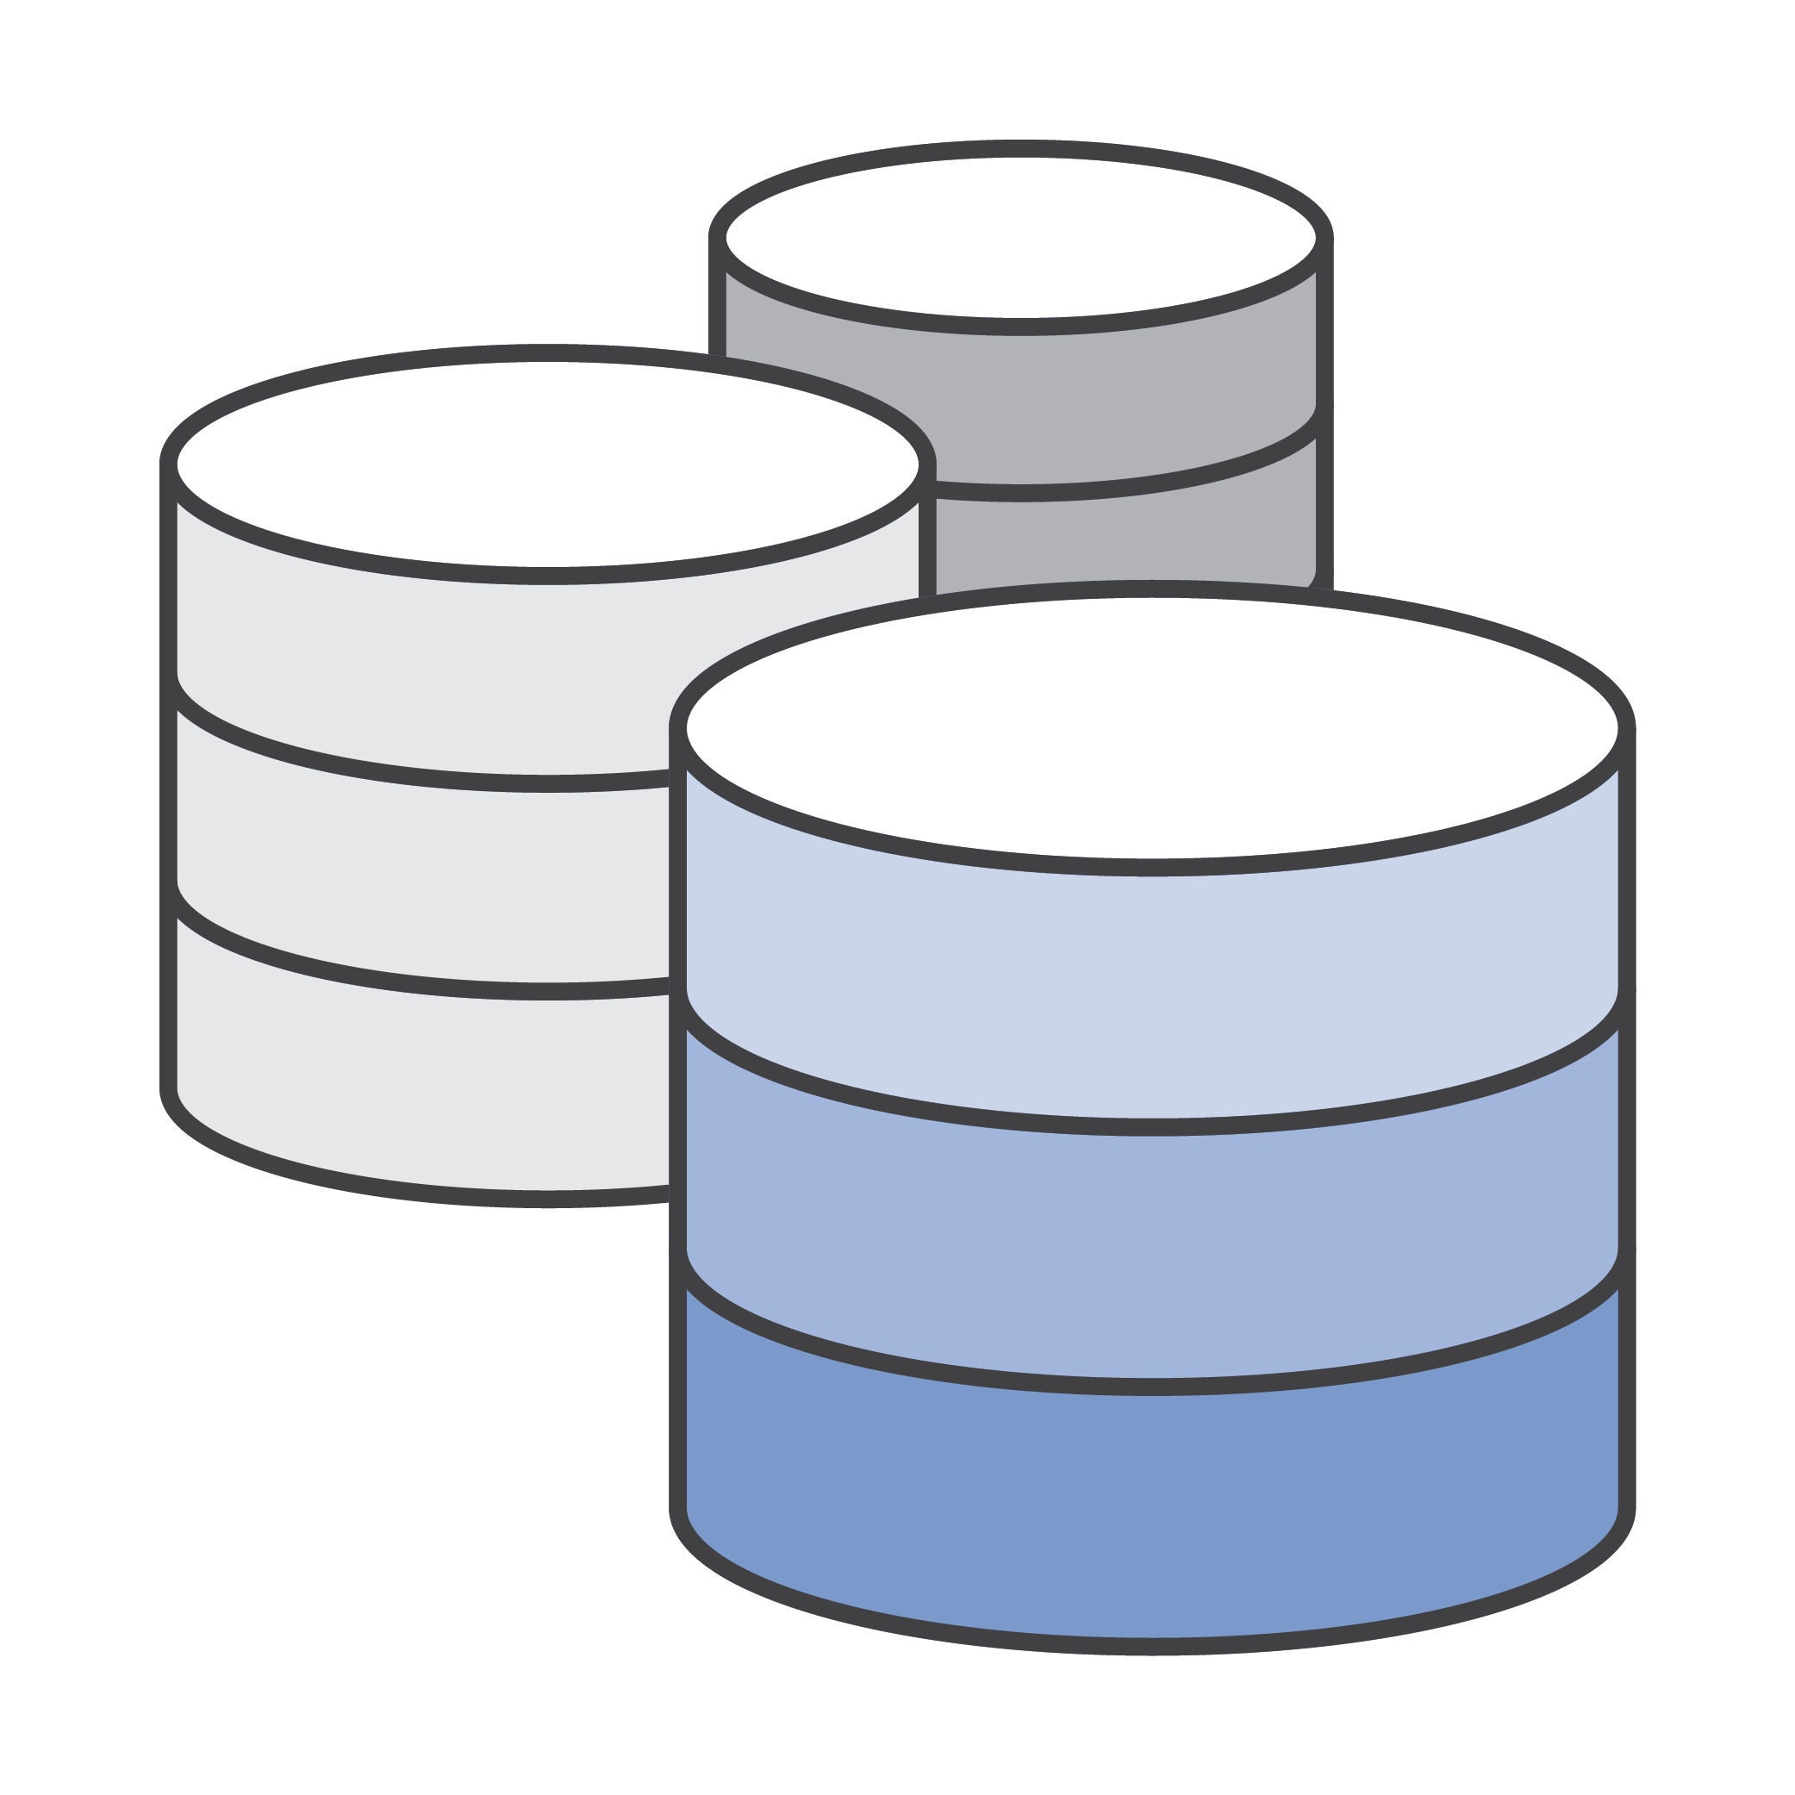
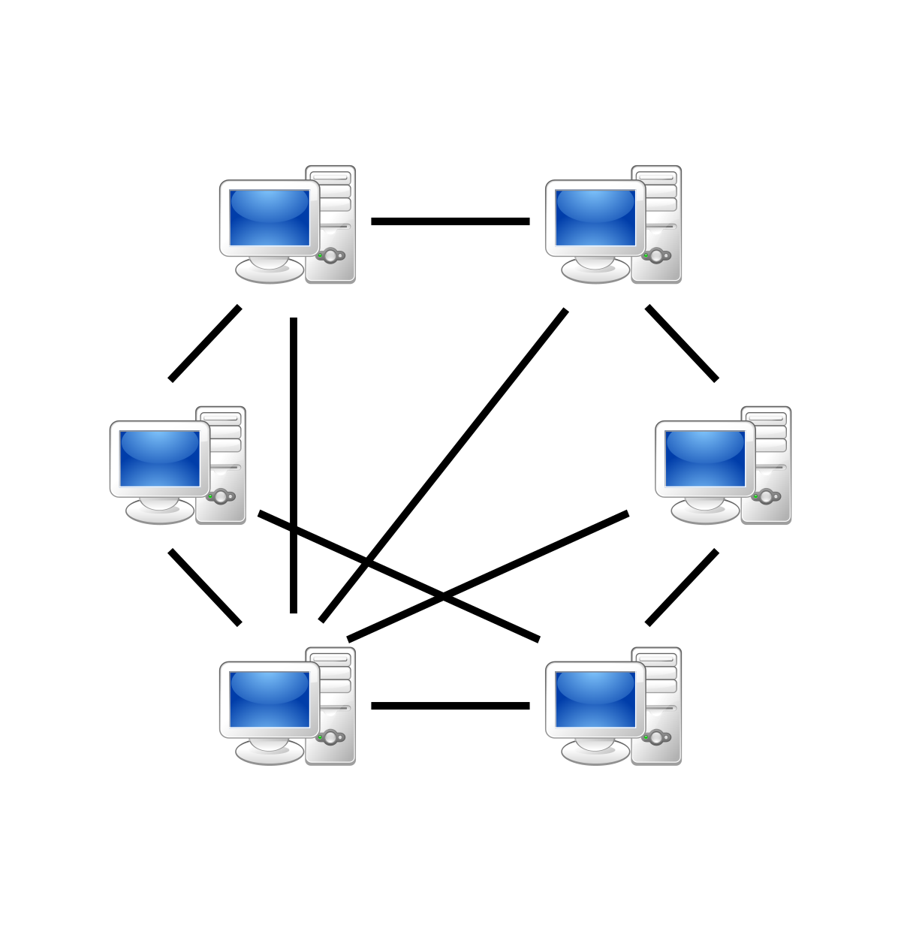
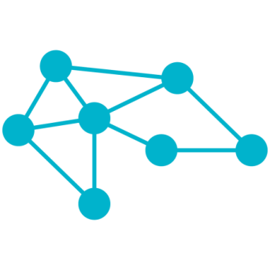


Key Characteristics
Distributed Ledger
Peer-to-Peer Network
Decentralized (No Owner)
Secure
Immutable

Slide 13
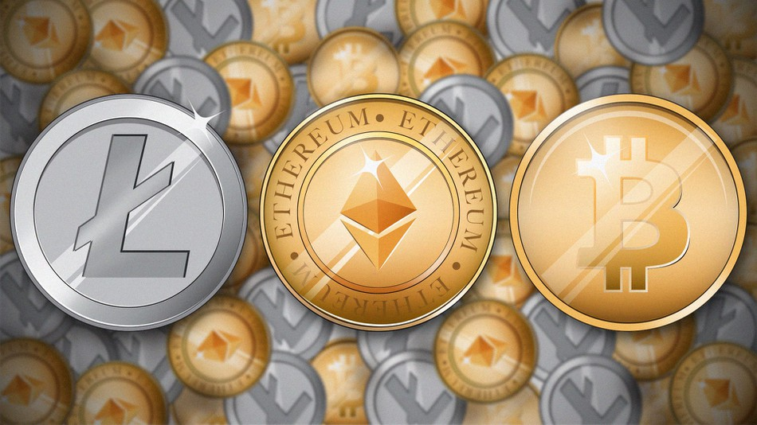
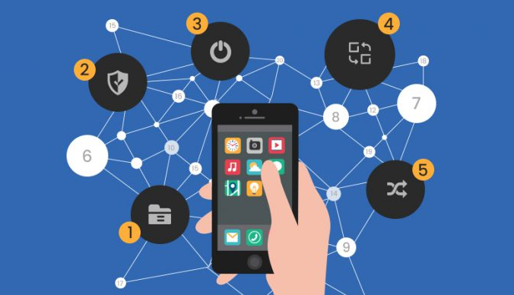

Applications
Cryptocurrencies
Digital Money with no Central Bank
Decentralized Apps
Removing the Middleman
Digital Investments
Fund Raising ICOs Token Sale Events

Slide 14
Transaction Processing
Blockchain Network
Consensus algorithm
Node #X
Transaction A
Node #1
Pending Transactions
Pending Transactions
Transaction B
Select winning node
Transaction C
Validate pending transactions & create next block
Node #2
Transaction D
Pending Transactions
Next/New Block
Confirmed Transactions
…
Propagate for validation
…

Slide 15

History of Blockchain

Slide 16
History of Blockchain
2008: Bitcoin: A Peer-to-Peer Electronic Cash System (Whitepaper by Satoshi Nakamoto)
2009: Bitcoin Offered as an Open-Source Code
2014: More than a Cryptocurrency
2015: Ethereum and Smart Contracts
Proof-of-Work vs. Proof-of-Stake vs. Proof-of-…
Today: 15% of Financial Institutions are Using Blockchain

Slide 17

Key Concepts of Blockchain

Slide 18
Structure
Back-linked structure of ordered data
Often visualized as vertical stack
Each block on top of the other
Tip
3
2
Blockchain
height
1
Genesis block
0

Slide 19
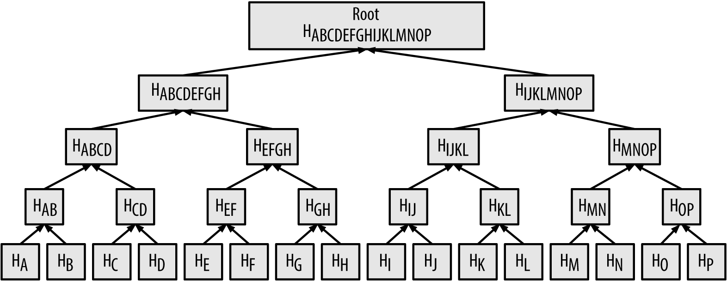
Technical Aspects
Each block is identified by a hash
SHA256 – bitcoin
Each block references the previous one – the parent
Each block contains its parent hash in its header

Slide 20
Block Relation
The sequence of hashes linking each block to its parent creates a chain going back all the way to the first block ever created, known as the genesis block.
When the parent is modified in any way, its hash changes.
This change affects the child block and all subsequent blocks
An example SHA256 generator

Slide 21
Digital Ledger
Think also of pages in a book
Blockchains by definition are:
Linear (but can have branches)
grow in chronological order
Blockchains are P2P networks, with each peer holding a copy of the ledger
contrast to client-server model (centralized)

Slide 22
Connectivity
Connectivity between peers can be
Over local network
Internet-based
Blockchains can exist locally
Not open to the wide Internet
Running two full-nodes in a local network
If no internet, the blockchain will continue to grow locally, if there are transactions

Slide 23
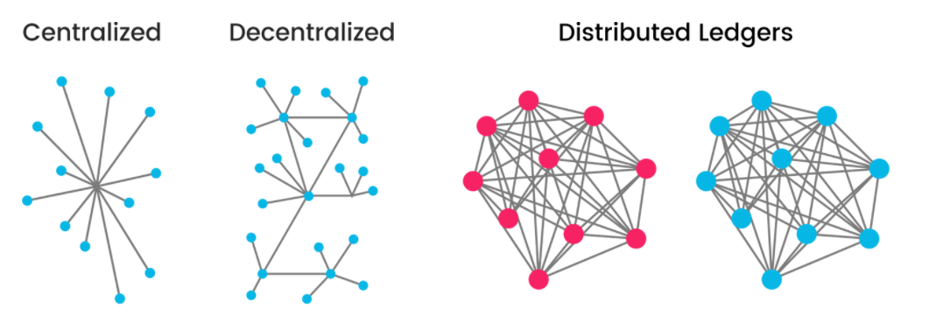
Network

Slide 24
Network
By definition blockchains are decentralized and distributed
i.e. a list of transactions is replicated across a number of computers(nodes), rather than being stored on a central server.
If a certain blockchain does not possess this attributes it is:
Either a private blockchain
Or a database incorrectly termed as a ”blockchain”

Slide 25
Network
Full nodes
Keep a complete copy of the blockchain.
Miners in a network
Create new blocks by running specialized hardware (ASIC) to solve the Proof-of-Work algorithm
Simplified Payment Verification (SPV)
SPV nodes don’t have all transactions and do not download full blocks, just block headers.

Slide 26
Consensus
A fundamental problem in control of multi-agent systems
Caused by Byzantine Fault Tolerance (BFT)
G1
attack
attack
city
?
G2
G3
retreat

Slide 27
Consensus
The consensus protocol does two things:
ensures that the next block in a blockchain is the one and only version of the truth
keeps powerful adversaries from derailing the system and successfully forking the chain
Currently, in Bitcoin, the SHA256 hashing must produce a sequence starting with 18 zeros. The number of zeros is set by the difficulty.
What are the chances to have a hash starting with 0? And 2^n – for every subsequent zero

Slide 28

Types of Blockchain

Slide 29
Public Blockchains
No central authority
Anyone can:
Read
Write
Verify transactions by participating in the consensus mechanism

Slide 30
Private Blockchains
Also called permissioned
Write permissions are centralized
Single person
Node
Group
Read access could be restricted
Could be granted to outside people

Slide 31
Consortium Blockchains
Hybrids between public and private ones
No central authority
Only selected participants can write or verify transactions.
Read access can be public or not.

Slide 32
Comparison of Types of Blockchains
Property | Public | Hybrid | Private
Permissioned | No | Yes | Yes
Decentralized | Yes | Partially | No
Trustless | Yes | No | No
Speed | Slow | Faster | Faster
Asset | BTC, ETH, etc | Per use case | Per use case
Consensus | PoW, PoS | PoW, PoS, Native | Native

Slide 33
Blockchain Applications & Implementations

Slide 34
Legal Issues
Deep web (onion protocol)
Developed in mid ’90s
Boomed in 2012 and 2013 with Silk Road
Terrorist funding
Money laundering

Slide 35
Supply Chain
Track shipment of goods
Guarantee arrival and processing
Streamline payment processes
Improve inventory management
IBM & Maersk

Slide 36
Insurance
Payment process automation
Trigger-based processes
GPS
Time
Condition
Data insights
IBM, MetLife and Majesco

Slide 37
Oracles
An entity that feeds data to smart contracts
In most cases it is off chain
Enables smart contract interaction with real-world data
Prediction markets
Oraclize, Aeternity, Augur

Slide 38
Voting
DAOs
Blockchain digital identity
Election systems replicated on the blockchain
Proportional vote
Majority vote
Digital identity
Immutable, crime resistant, transparent

Slide 39
Data Access
On-chain business logic
Off-chain data
Pay-per-read

Slide 40
Side Chains
Alternative blockchains
In parallel to bitcoin’s or other
Send crypto to an address on a blockchain
The balance of this address is the basis for the sidechain-based token
Extend functionality and interoperability
Transfer value off-chain
Drivechain.info, Elements Project

Slide 41
Side Chains: Sample Schema
B1
B2
B3
B4
B5
S1
S2
S3

Slide 42
Homework Assignment
Multiple Choice Test (online)
Watch My “Investing in Cryptocurrencies” Seminar:
https://softuni.bg/trainings/resources/video/29657/video-stream-record-07-march-2018-mihael-mladenov-investing-in-cryptocurrencies/1906
Think About:
What Happens with the Network if Access to the Internet Stops?
What Happens to the Blockchain? Does it Continue to Exist?

Slide 43
Resources & Further Reading
Nick Szabo – Money, Blockchains and Social Scalability
One of Szabo’s most recent analysis of the Bitcoin system
Blockchain Hub – Blockchain Technology
Short introductory article
Blockchain Hub – Blockchains and Distributed Ledger Technologies
More on blockchain types
Udemy – Blockchain 101
A great overview, delivered by Hudson Jameson

Slide 44
Resources & Further Reading
Gavin Wood – Blockchain What and Why
A concise introduction by one of Ethereum’s founders
The Four Layers of the Blockchain
An analysis that also discusses applications
Blockgeeks – What is Blockchain Technology
Another introductory article
Consensus in Computer Science
The wiki article on consensus

Slide 45
Resources & Further Reading
Decoding the Enigma of Bitcoin Mining
This article focuses on mining and validation
Mining Bitcoin with Pencil and Paper
For the more math-oriented - how to calculate hashes by hand
Tor Anonimity Network
The wiki article on the Tor Network
SoftUni Blockchain Meetup – November 2017
Check out the presentations

Slide 46
Resources & Further Reading
Don Tapscott – Blockchain Revolution
One of the definitive books on the topic
How the Blockchain Is Changing Money and Business
A very straightforward explanation of blockchain
Andreas M. Antonopoulos on YouTube
What you watch, it is worth it
A collection of important news on Bitcoin and blockchain
My personal collection

Slide 47
Summary
Blockchain Makes Use of a Number of Well-Known Technologies
Blockchain Eliminates the Need for a Third Party/Middleman
Digital Ledger – Decentralized, Provable, Immutable
Blockchain Consists of Data, Network & Consensus
Public, Private & Consortium Blockchain Networks
Blockchain Networks Do Provide a Lot of Benefit to Industry and Businesses

Slide 49
Diamond Partners

Slide 50
Diamond Partners

Slide 51





Trainings @ Software University (SoftUni)
Software University – High-Quality Education, Profession and Job for Software Developers
softuni.bg
Software University Foundation
http://softuni.foundation/
Software University @ Facebook
facebook.com/SoftwareUniversity
Software University Forums
forum.softuni.bg

Slide 52

License
This course (slides, examples, demos, videos, homework, etc.) is licensed under the "Creative Commons Attribution-NonCommercial-ShareAlike 4.0 International" license

